Slide 1
Acquiring Korean Weather Data
from Korea Meteorological Administration(KMA)
XLARGE team / 2017 KSQ
Junhu Kang, Seunggeun Baek
Notes:
I and seunggeun searched how to acquire Korean Weather data. Let’s go to the next page.

Slide 2
Weather Data Providers in Korea
As a part of the government, Korea Meteorological Administration(KMA) provides reliable weather source.
KMA does not provide public API, though it seems to do for authorized people only.
We are looking for another data providers. Currently Kweather and Weather-i provide some data, mainly relaying KMA data, but not in the form of API.
Notes:
First Weather Data Providers in Korea.
Korea Meteorological Administration(KMA) which is a part of the government, provides reliable weather source.
KMA does not provide public API, though it seems to do for authorized people only. So we have to sign in that website and request the permission.
We are looking for another data providers. Currently Kweather and Weather-i provide some data, but they relay KMA data, also doesn’t give data in the form of API.

Slide 3
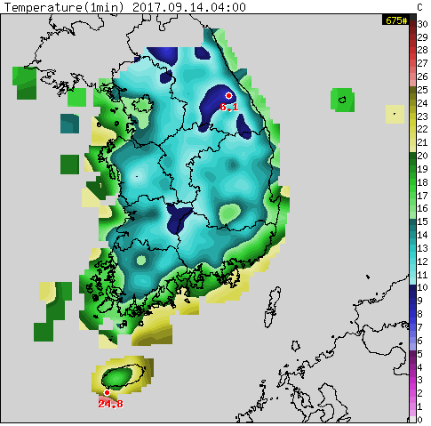
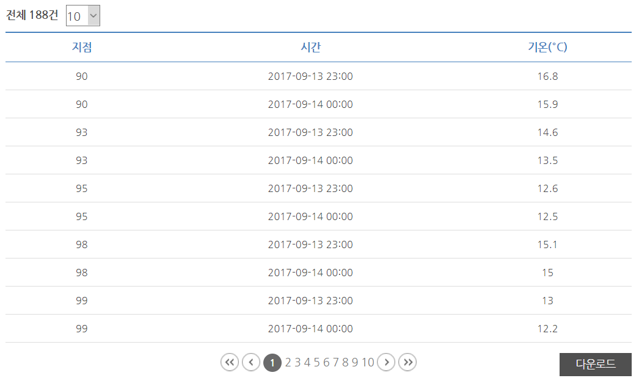
2 Strategies to Collect Data
Data Collection by Stations
Data Collection by Image
Notes:
There are 2Strategies to Collect Data
1. 2. we gonna compare these 2 things.

Slide 4
Data Collection by Stations
Weather Data Open Portal, Big Data Platform

Slide 5
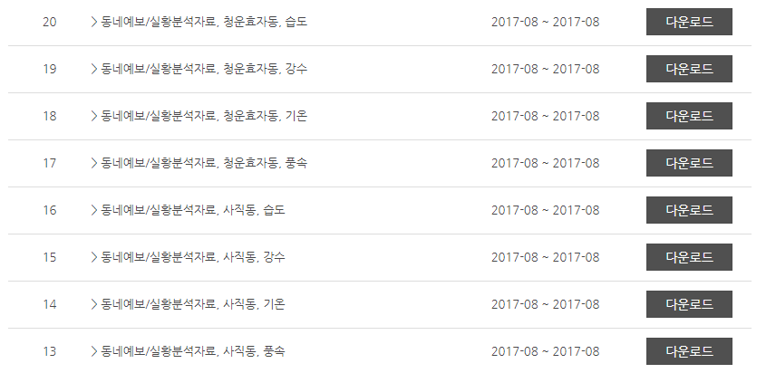
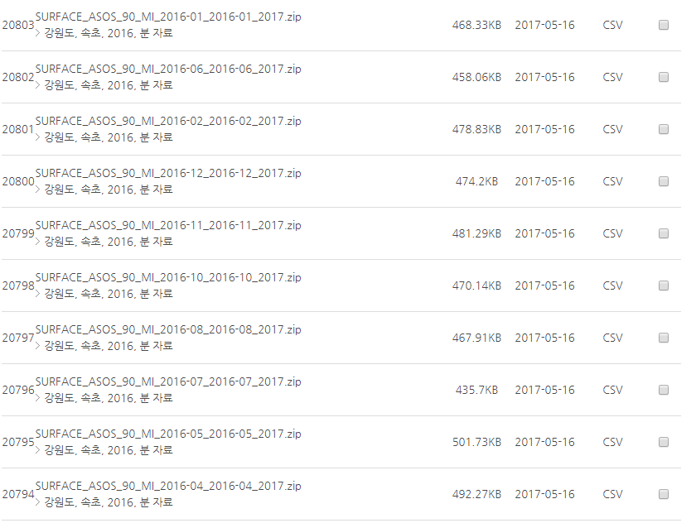
Weather Data Open Portal(data.kma.go.kr)
Features
Exact values
Can extract data that we want
Easy to get a old data
Data is divided into locations
Outdated( 9 hours delayed)
Data is measured from various methods
(AWS, ASOS, Satellite, etc.)
There are many choices(annual, daily, weekly, ocean weather, etc.)
Notes:
We can use exact values, can extract data that we want, easy to get a old data. Data is divided into locations. But it is outdated. About 9hrs delayed.
Pricipitation 강수량
Wind speed 풍속

Slide 6
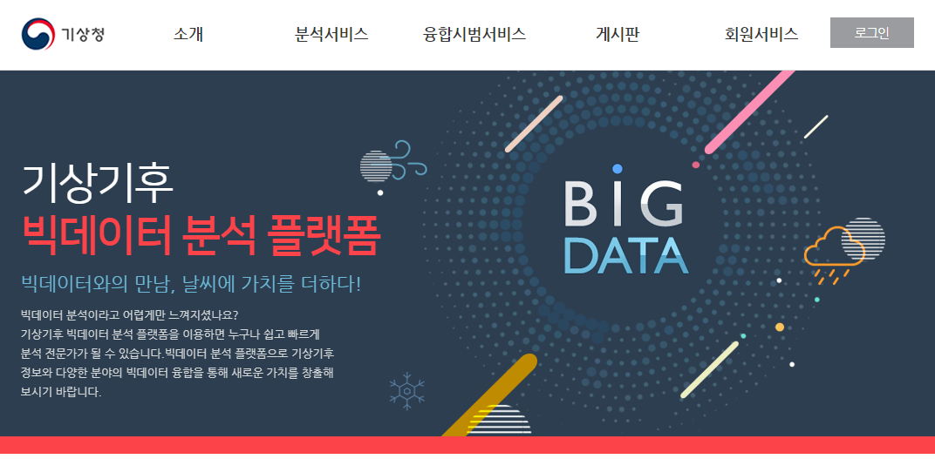
Weather Big Data Analysis Platform(data.kma.go.kr)
Only authorized person can access this.
Now we are waiting for getting permission.

Slide 7
Data Collection by Image
AWS & Prediction Data from KMA

Slide 8
Images: Pros & Cons
Pros
Cons
Easy to Visualize
Easy to map (long,lat) coords
From Social Media, etc
Real-time
Ignoring stations on failure
Hard to map county info
Hard to generate forecast, if it follows the county-based model
Image processing is required

Slide 9
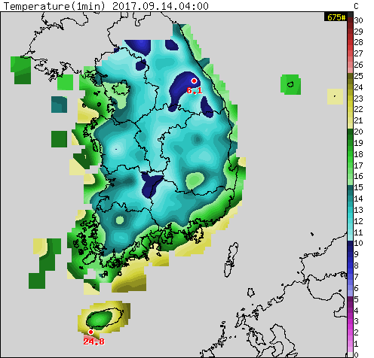
Collecting Current Weather
AWS Map (1.5km/pixel)
Created from interpolation based on data from stations
Update : 5 min.
Temperature(current, high, low), Precipitation(15m,1h,12h,daily), Wind speed, Humidity, etc.

Slide 10
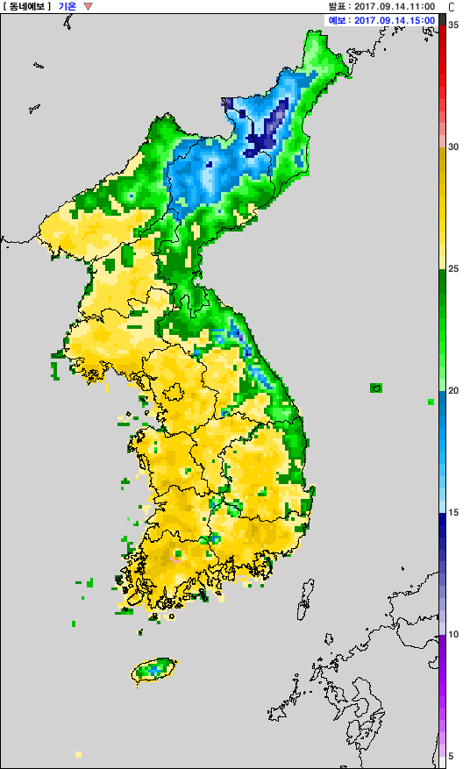
Collecting Forecasts
Forecast Map (1.5km/pixel)
Directly created from the atmosphere model
Prediction Unit Grid: 5km
Update: 1 hr.
Provides same data with AWS except precipitation(6h only)
Same image resolution, but includes North Korea

Slide 11
Where to Retrive Images
AWS Current Weather Image
/cgi-bin/aws/nph-aws_ana1?201709140935_-60_0_mtc_460_A0_CENN_m_15_1_h
[Datetime]_[Offset]_0_[Type]_460_A0_CENN_[Option]_15_1_h
(Option is “m” by default. If “a”, the most recent image is displayed and datetime/offset are ignored)
Forecast Map
/img/dfs/GEMD_T3H_G1_0000000_0000000_M_E_G_S_500_201709141100_201709141500_122_SHRT.png
[Type] [Base Time] [Forecast Time]

Slide 12
How to deal with images
Mining
Retrieve images from the website
Processing
Extract values from matching colors, apply mask if necessary.
Using image processing libraries such as OpenCV
Analysis
Integrate with Medical data / Social Media Data
Construct forecast model / run with forecast weather images
Using web-accessing libraries such as cURL, writing own code, …

